Slide 1

Slide A
Navigation
Let’s look back at our criteria list from last time. One criterion we identified was related to materials. We want to use materials that will protect our object.
With Your Class
What does it mean to use good materials that are protective? What would those materials do?
How do you think those materials function?
How do we think those materials help reduce peak force or energy transfer to the object we are trying to protect?
Notes:
Recall criteria for our protective device from the previous lesson. Project slide A. Say, Let’s look back at our criteria list from last time. We know that in order to have an effective protection device design we need to meet our criteria. One criterion we identified was using materials that will protect our object. What does that mean?
Example prompts and responses are located in the teacher guide.
Say, It sounds like we have some varied ideas on what exactly it means to have a protective material and what that material does to help reduce the peak forces in a collision. We need to figure out which materials would best fit the goal of protection for our objects. Turn and talk with a partner about other things we have done to measure peak force that we might be able to reuse today.

Slide 2

Slide B
Determining Investigation Setup
Last lesson, we determined that we needed to test materials to figure out what might reduce the amount of peak force on our objects.
Turn and Talk
How have we measured peak force in the past that we could reuse or repurpose for our investigation today?
Be prepared to share your ideas with the whole class.
Notes:
Share protective material ideas. Project slide B. Give students a moment to turn and talk. Once students have had a chance to talk with a partner, bring the class together and have students share their ideas. Example prompts and responses are located in the teacher guide.

Slide 3

Predicted Material Performance
Slide C
Making Predictions
Material | Predicted performance
cotton balls
balsa wood
foam earplugs
Styrofoam
cardboard
metal
CD case plastic
large bubble wrap
small bubble wrap
fabric
Make a prediction about how the materials will perform in our tests compared to no material at all.
Create the chart to the right in your notebook.
Next, rate the materials on their predicted performance during a collision.
+ if peak forces will increase
- if peak forces will decrease
= if peak forces will remain the same
Circle the material you think will reduce peak forces the most in a collision.
Notes:
Tell students that after looking at their designs from the gallery walk in the last class and seeing the materials they used, you were able to find certain comparable materials around the classroom for them to test.
Make protective material predictions. Project slide C. Show students each material. Either pass out to each student a copy of the materials chart from Material Charts or have students create in their notebooks the chart from slide C. Ask students to make predictions about which materials will better reduce peak forces in a collision. Students will add the following markings in the second column on their charts to indicate their predictions:
+ if the material will increase peak forces during a collision
- if the material will reduce peak forces during a collision
= if the peak forces will remain the same during a collision
Ask students to look at the materials for which they marked a minus. Have students circle a material with a minus that they think will do the best job of reducing peak forces in a collision.

Slide 4
Comparing Ideas
Slide D
Turn and Talk
What material do you think will reduce peak force the most? Why?
What material(s) do you think will perform the worst? Why?
Be prepared to share your ideas with the whole class.
Notes:
Share ideas with a partner. Project slide D. Once students have had a chance to make predictions about materials, have them turn and talk with a partner about their predictions. Have students use the following questions to guide their partner discussion:
What material do you think will reduce peak force the most? Why?
What material(s) do you think will perform the worst? Why?

Slide 5
Comparing Ideas
Slide E
Whole-Class Poll
Your teacher will read off the list of materials. Raise your hand if you think that material will best reduce peak forces.
Your teacher will read the list a second time. This time, raise your hand if you think the material will perform the worst at reducing peak forces.
Be prepared to share your reasoning for your vote!
Notes:
Take a class poll over materials ideas. Project slide E. Bring students together and have them share their ideas on the best and worst performers by taking a class poll for each. For the first poll, read out loud each material listed in the chart, pausing after every one. Have students raise their hand if they think the material will be the best performer. If any material has several hands raised, ask students why they think that the material would be the best at reducing peak forces. Continue the process of reading the materials, taking a poll, and asking students their reasoning until all materials have been read.
Take a second poll, Ask students which materials would do the worst at reducing peak forces. Explain to students that this could mean that they are reducing the forces very little or not at all or even increasing the forces. Read through the list of potential protective materials again, pausing after each one to take a poll, and, for materials that have several hands raised, asking students why they think that particular material would do the worst at reducing peak forces. Accept all answers. Keep going until all materials on the list are read.
Say, Interesting. It seems that we have different ideas on which materials would be best to use in our designs and even which materials we would want to avoid for protective purposes in our designs. We also have some ideas about why those materials might work or not work, but we aren’t sure. We’ll need to collect some data to see which of our predictions are supported and which are refuted by the evidence.

Slide 6
Testing Materials
Slide F
We need to figure out if our potential protective materials will reduce peak force in a collision.
Whole-Class Discussion
Where would we have to place the material so that we could see if it reduces the peak forces on our colliding objects?
How can we secure the test materials in place when we are running our tests?
Notes:
Determine materials lab setup. Project slide F. Show students the basic setup at the demonstration table. Draw attention to the peak force collar that was used in Lesson 5. Ask students the following prompts:
We want to see if our materials reduce the peak force in a collision.
Where would we have to place the material so that we could see if it reduces the peak forces on our colliding objects?
How can we secure the test materials in place when we are running our tests?
Discuss the two questions as a whole group. Students should determine that the potential protective material should be placed in the middle of the collision, in between the two objects that are colliding.
Explain material setup. Instructions can be found in the teacher guide.
Review force collar use. Instructions can be found in the teacher guide.
Create the need for multiple trials. Now that students have had a chance to view the setup, say, Let’s do this demonstration one more time to make sure we know how it works.
Intentionally lift the cart to a slightly different height on the track and release the cart. Have a student read where the force collar rests. Point out that it is at a slightly different spot.
Ask students:
Will we always get the exact same results?
Students should respond that it depends on the trial and that small differences can occur. Ask students what we can do to account for these small differences. Elicit the idea that we can take an average of the data to account for small differences in how we release the cart and other variables that are hard to control.
Controlling for other factors. Explain that we will also have to keep track of the mass of our carts. As we figured out in Lesson 5, the mass affects the amount of kinetic energy an object has, which in turn affects the peak force. Because of this we will use a digital scale to make sure all carts weigh exactly 200 g. Show students how to add clay to the cart cavities on top to adjust the weight of the cart to 200 g.
Run the demonstration at least 2 more times to demonstrate to students how to check for semi-consistent results. Explain to students to look at their data once they are finished. If there is a larger variance than +/- 0.2 N from the mode of their measurement, check that the collar isn’t loose and rerun that trial.
Introduce Force Reduction Chart. Post the Force Reduction Chart in an easily accessible part of the room for students. Explain to students that they will be splitting up to test different materials listed on the chart. These materials are readily available, and while they may not reflect all materials they are wanting to use in their design, the materials we have to test have very similar features.
Assign groups and distribute test materials. Divide the class up into groups to test the materials. Label the materials 1-10. Randomly assign the materials to groups using the method determined in the Lab Preparation section of the Teacher Guide, such as choosing sticks, counting off by 10, and so forth. Have a student from each group collect the testing materials for their group. Explain that they will not be given extra materials, so they should use the materials carefully. Bubble wrap and other materials should not be popped or destroyed.

Slide 7
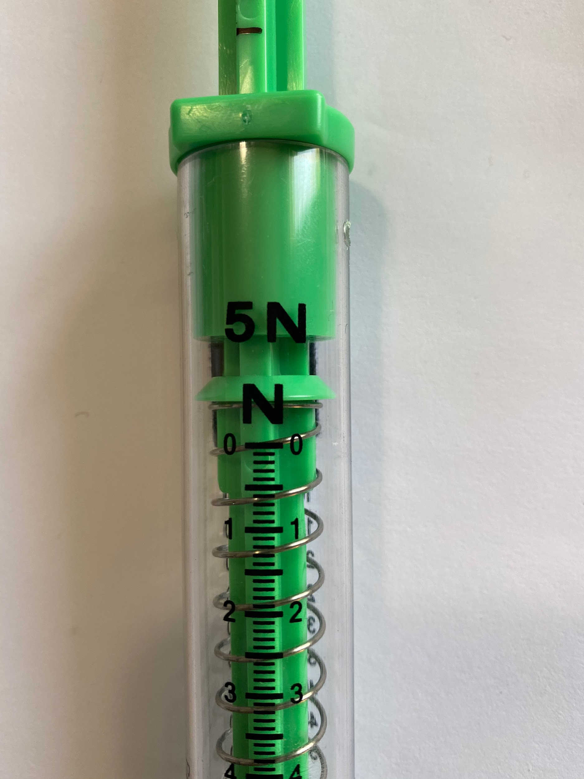

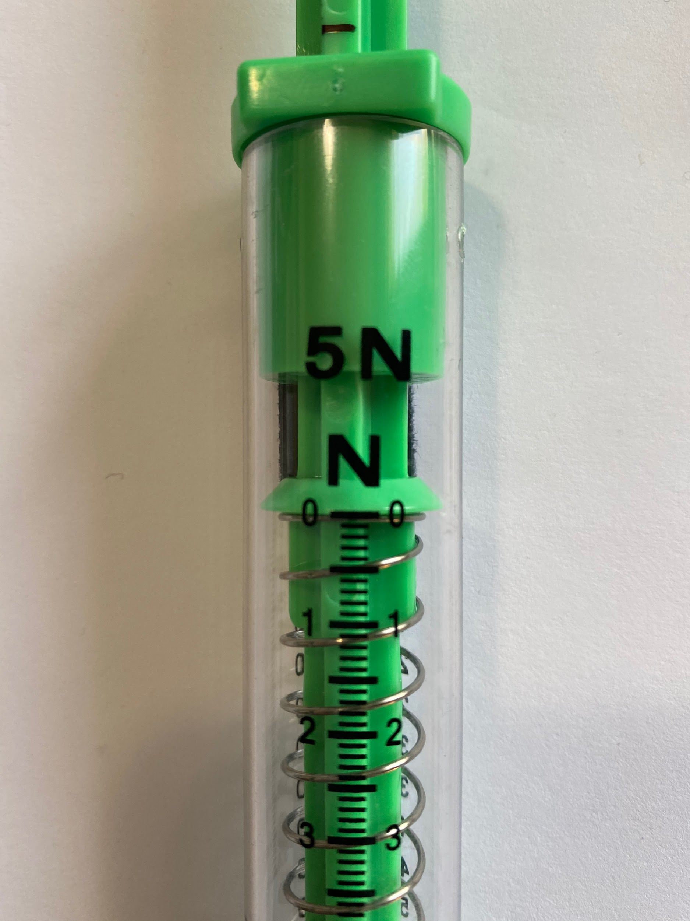
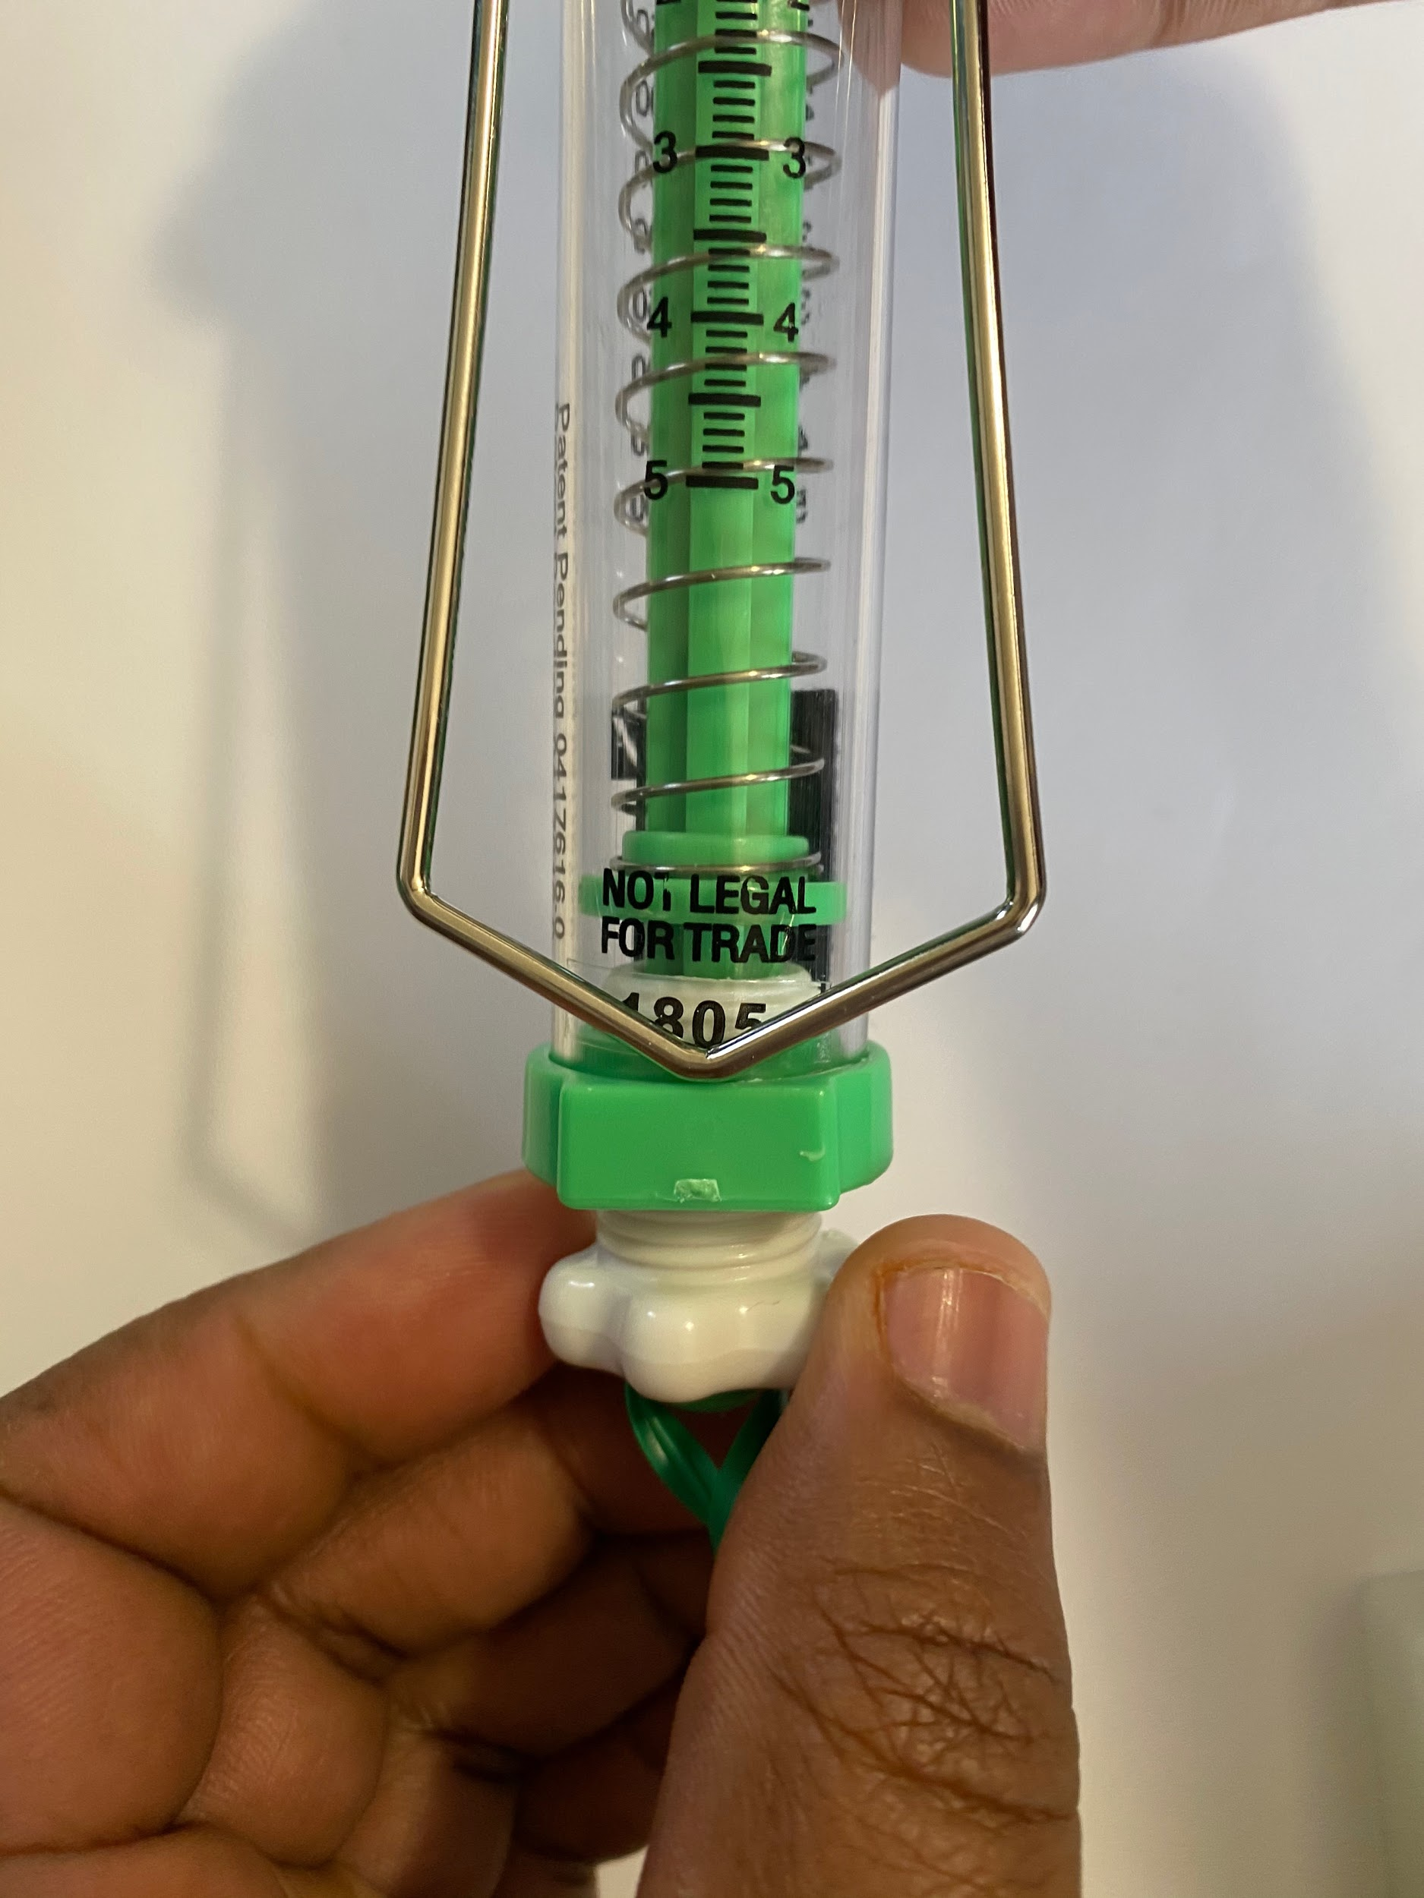
Create Accurate Readings
Slide G
Device Calibration
not at 0 newtons
Check your spring scales. Do they show 0 newtons when held on their sides?
Push in and out on the spring scale rod a couple of times and make sure that it rests at 0 newtons.
If it is not at 0, use the white screw on the end to adjust the scale. Once you have it set, push in on the rod and let go to check that it rests at 0 newtons.
at 0 newtons
Notes:
Calibrate group devices. Project slide G. Direct students to set up the spring scale, cart, track, flooring strip, books, and brick in the same arrangement as the teacher demonstration setup. Distribute a piece of duct tape to every group for students to secure the nonmoving cart. Instruct students to follow the directions on the slide to calibrate their spring scales. Explain that it is important to calibrate the spring scales first so we can accurately compare the potential force reduction data from our materials testing.
Check your spring scales. Do they show 0 newtons when held horizontally?
Push in and out on the spring scale rod a couple of times and make sure that it rests at 0 newtons.
If it is not at 0, use the white screw on the end to adjust the scale. Once you have it set, push in on the rod and let go to check that it rests at 0 newtons.

Slide 8
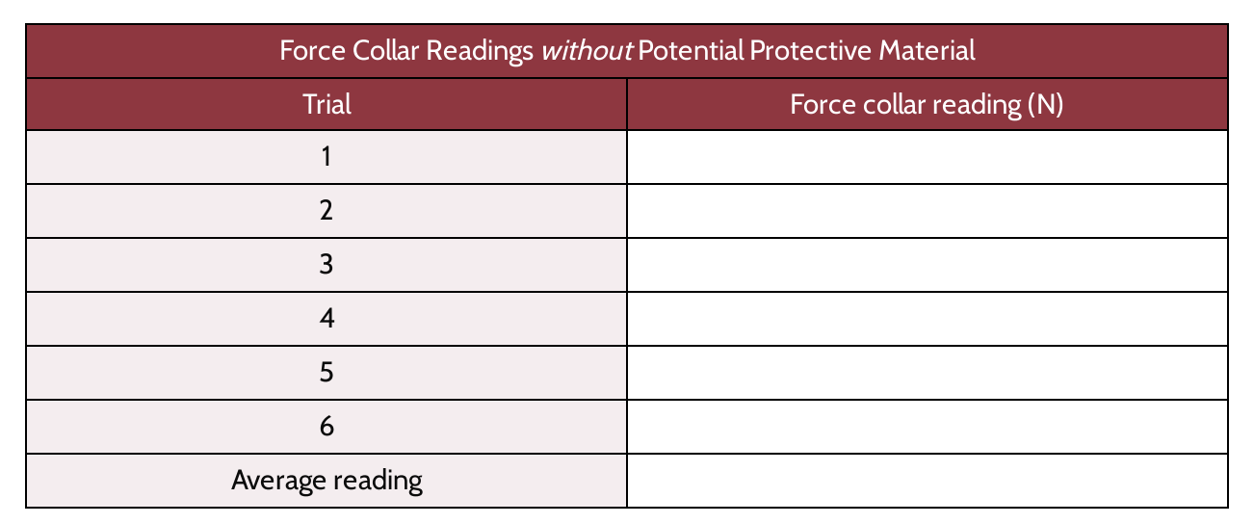
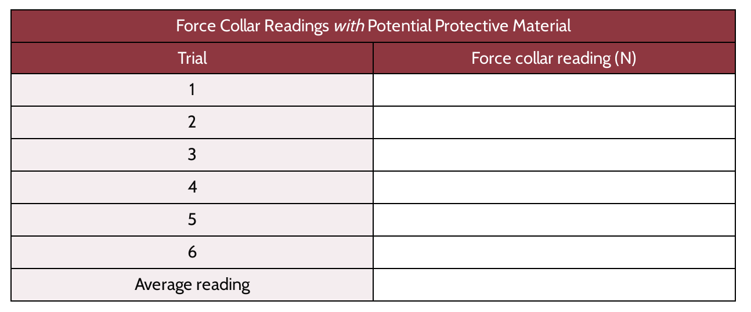
Procedure
Slide H
Record your data in these tables on your handout. One is for your data without test materials; one is for your data with test materials.
average of test without materials |  | ________________ N
(subtract) -
average of test with materials |  | ________________ N
average amount of peak force reduction |  | ________________ N
This area is set up to help you find the peak force differences.
Summarize here:
The average peak force reduction of our material ____________________ is ______ newtons.
Notes:
Distribute testing procedures. Project slide H. Distribute Cushioning Materials Testing Procedures to students. Read through the directions with students and have them highlight or star the places where they will stop and record their data. Point out the differences between the two data tables and explain how to use the subtraction table located in the final section to help students find the difference in peak forces during the collisions.

Slide 9
Materials Testing
Slide I
Conducting Material Tests
Use your lab setup to run tests both with and without the potential protective material in your collision.
Follow the directions on the Testing Procedures sheet and make sure to record your data as you go.
If your data has a large range, first check that your force collar is not loose. After data collection, if one trial is +/- 0.2 N more than the average, redo that trial.
Once you are done, subtract the peak force average with a protective device from the peak force average without protection.
Record your results on the class chart.
Notes:
Conduct materials tests. Display slide I. Once it has been verified that all the devices are calibrated, have students run 6 tests without the protective material in the system and record the data for each trial on their handout. Students will need to establish a baseline, or control, for their readings to determine if the protective materials actually reduce peak force on their objects. Explain that there are variables that we cannot control for in the way we set up our work stations (e.g., some wheels may be slicker than others, some peak force collars may be slightly tighter than others), but by comparing the peak forces of the control and the experimental trials at each station, we will get a better picture of the overall peak force reduction potential of the materials.
Remind students to use tape, not sticky tack, during the second part of the investigation to add their material on the carts’ electrical plates. Make sure students keep the test materials in line with the plunger as much as possible. Students will run each test 6 times, then average their data.
After data collection is completed, students will then find the difference between the control peak force average and their materials test peak force average and add it to the class chart. These data will be reviewed individually and as a class during the next class period and should be checked as students are recording their data. Once students are finished adding their data to the class chart, have students dismantle their lab setup, put away materials, and return the protective materials for use in the next class period. Here is an example of a completed class chart.

Slide 10

Analyzing Results
Slide J
Look back at the class data from our lab.
Answer the following questions in your notebook:
What materials seemed to do the best at reducing peak force on the nonmoving object?
What patterns in material structure do you see in these “top performers?”
Think about the materials. What special features or properties of the material’s structure would make it function better than a worse-performing material?
How do you think the structures of the materials behave in a collision that would reduce the peak forces on the objects?
Was the peak force reduced on both objects or just the nonmoving object?
Notes:
Individually reflect on results. Display slide J. Have students look back at the data collection table from last time. Instruct students to reflect on the data and answer the following questions in their notebooks:
What materials seemed to do the best at reducing peak force on the nonmoving object?
What patterns in material structure do you see in these “top performers”?
Think about the materials. What special features or properties of the material’s structure would make it function better than a worse-performing material?
How do you think the structures of the materials behave in a collision that would reduce the peak forces on the objects?
Was the peak force reduced on both objects or just on the nonmoving object?

Slide 11
Reviewing Class Data
Slide K
Turn and Talk
What materials were our “top performers” or seemed to work best to reduce peak force on the nonmoving object?
What patterns in material structure did you see in the “top performers?”
Did the material reduce the peak force on both objects or just on the nonmoving object?
Be prepared to share your ideas with the whole class.
Notes:
Review materials data to determine which reduced peak forces best. Display slide K. Ask students to turn and talk about the questions on the slide. After 2 minutes, bring the class back together and discuss the questions as a whole class.
What materials were our “top performers” that seemed to work best to reduce peak force on the nonmoving object?
What patterns in material structure did you see in the “top performers”?
Did the material reduce the peak force on both objects or just on the nonmoving object?
Have students share out their ideas. Sample student responses are located in the teacher guide.
Say, Interesting, we didn’t collect data on the other cart, so we can’t be sure that it reduced peak forces on both carts in the collision.
Ask students the following question: What do you think would happen to the peak forces on both objects if one cart had more kinetic energy than another cart before the collision, either by an increase in weight or increase in speed?
Allow students to respond to the question. Students may bring up the following ideas:
In Lesson 5 we figured out that the peak forces should be the same, but we are not sure if that is still the case when there is some type of material in between them.
Maybe the padded material just protects the nonmoving object more.
Draw attention to the idea that we know from Lesson 5 that the objects involved in a collision both push on each other equally, but when we add a material in between we can’t be sure that the force isn’t reduced by the material, causing one side to experience more peak force than the other. We also had the carts calibrated to be the same mass as we conducted our investigation on day 1.

Slide 12
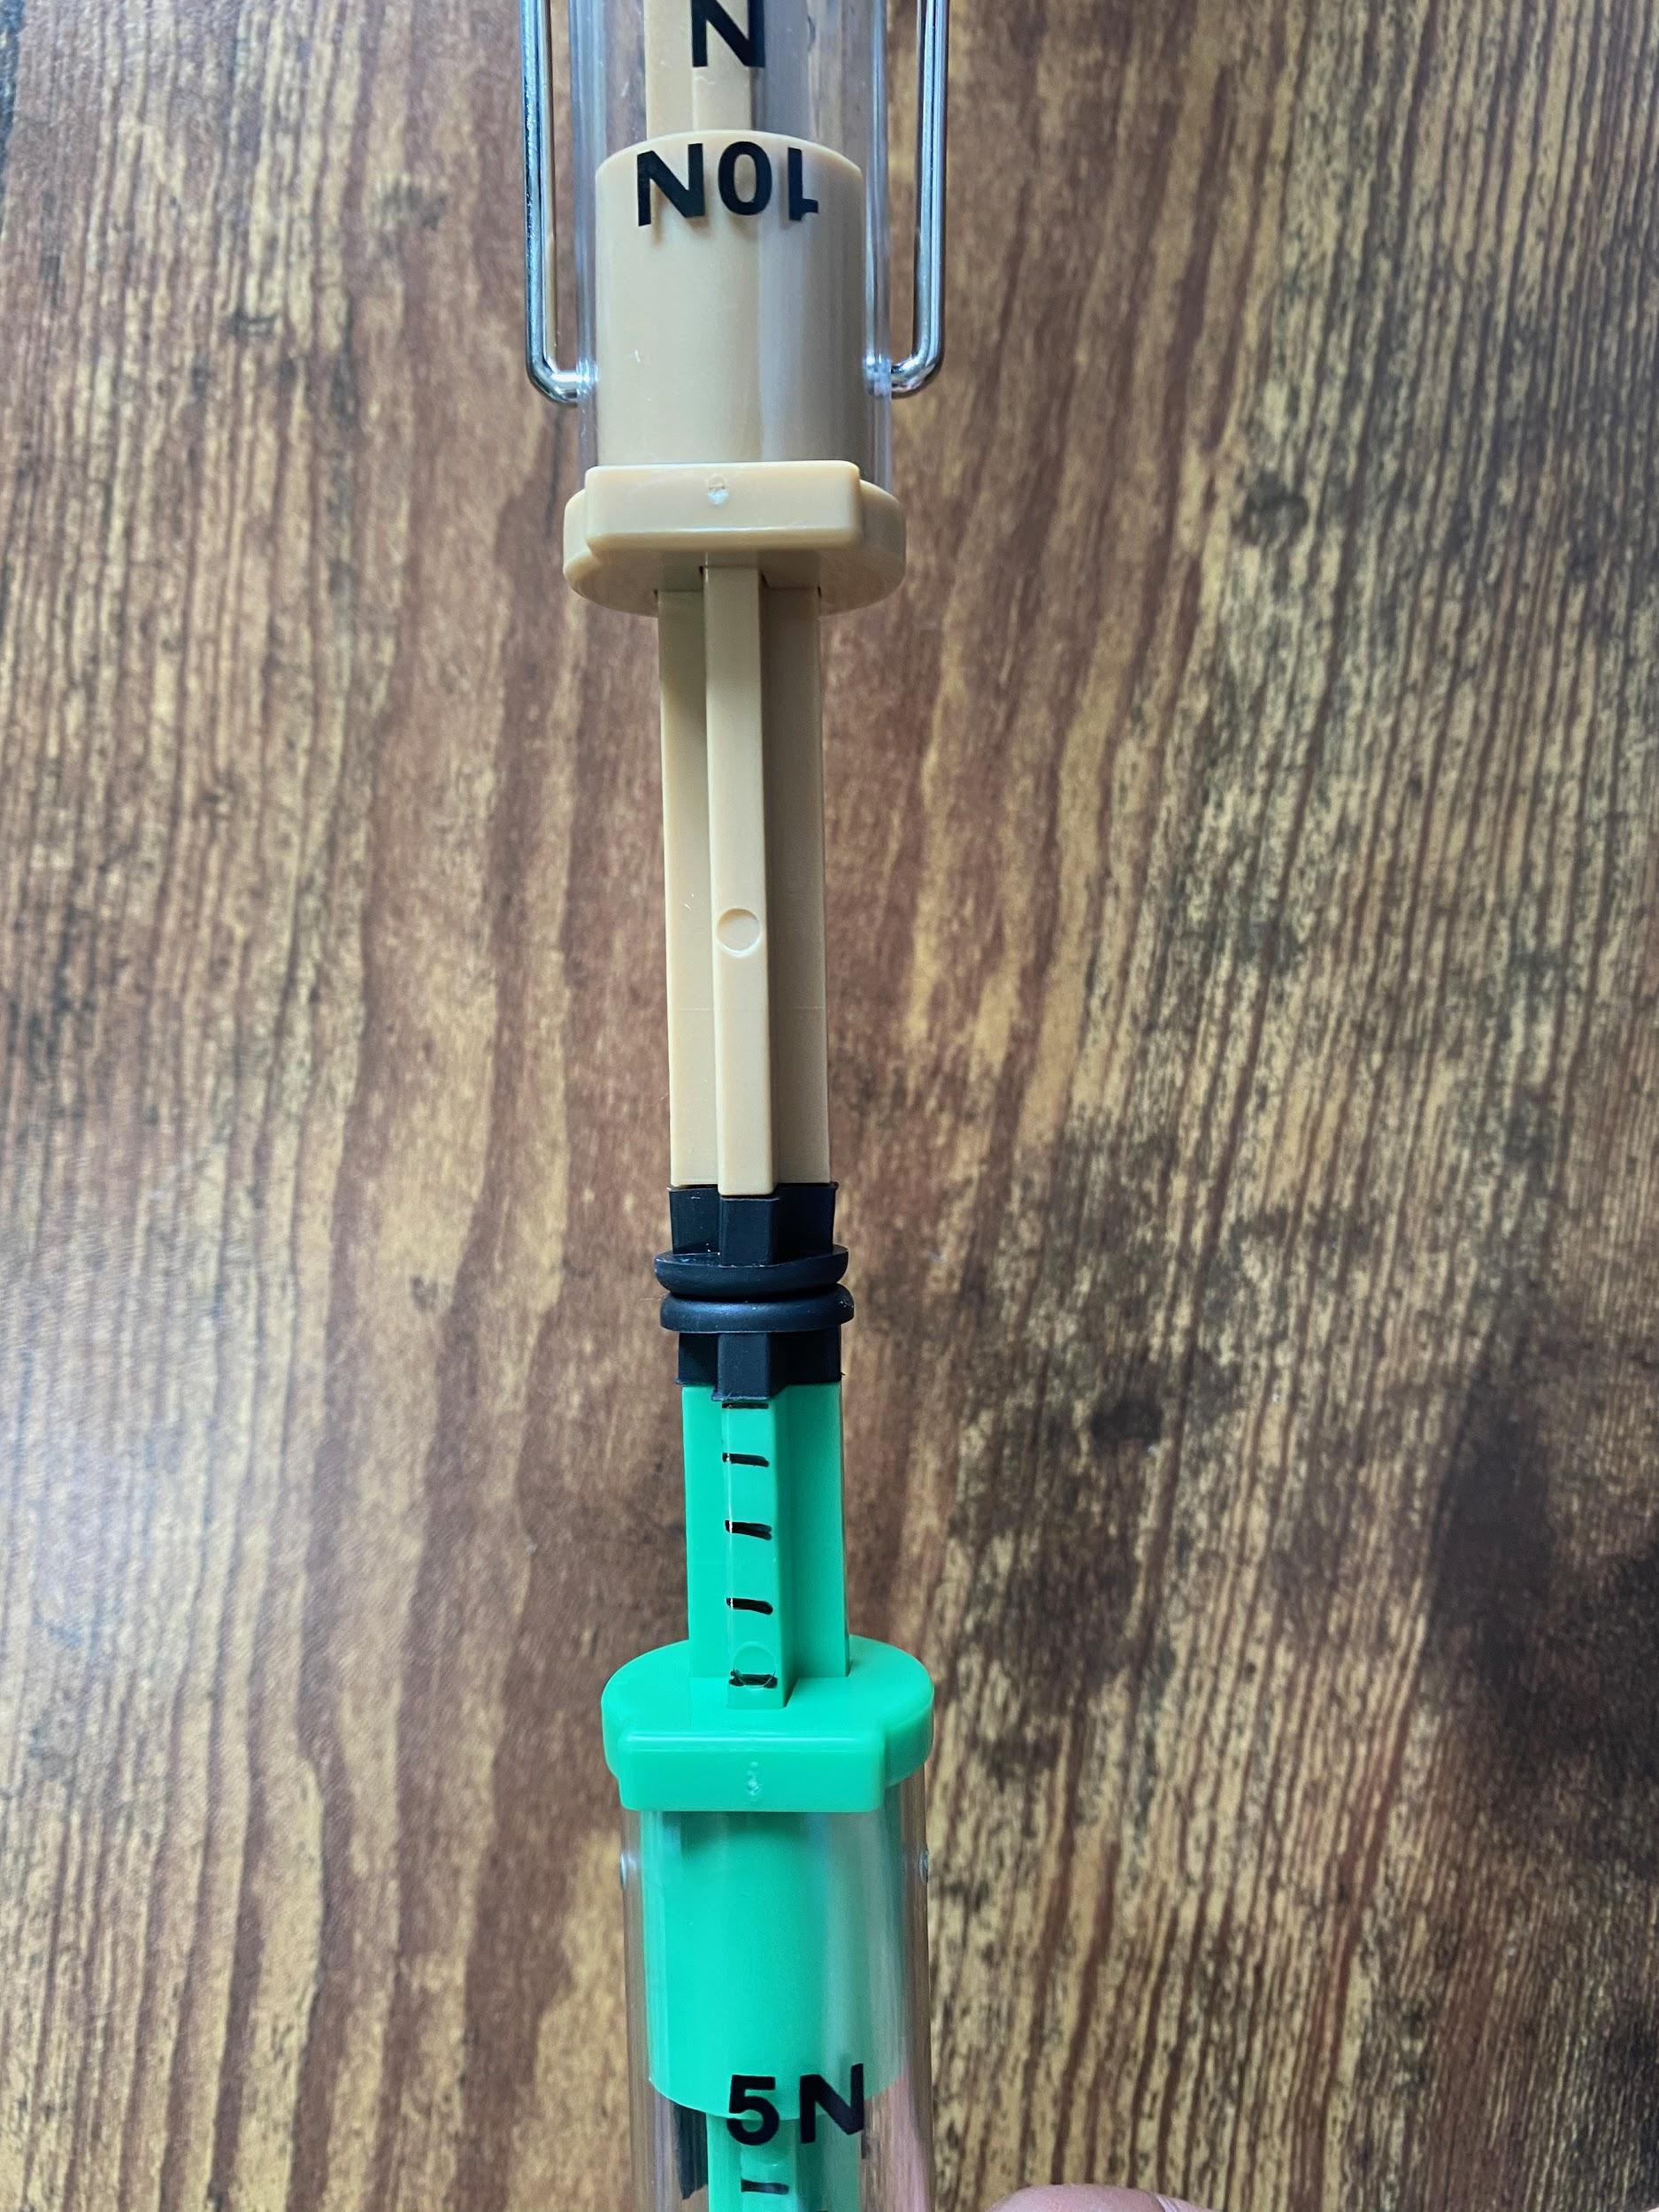
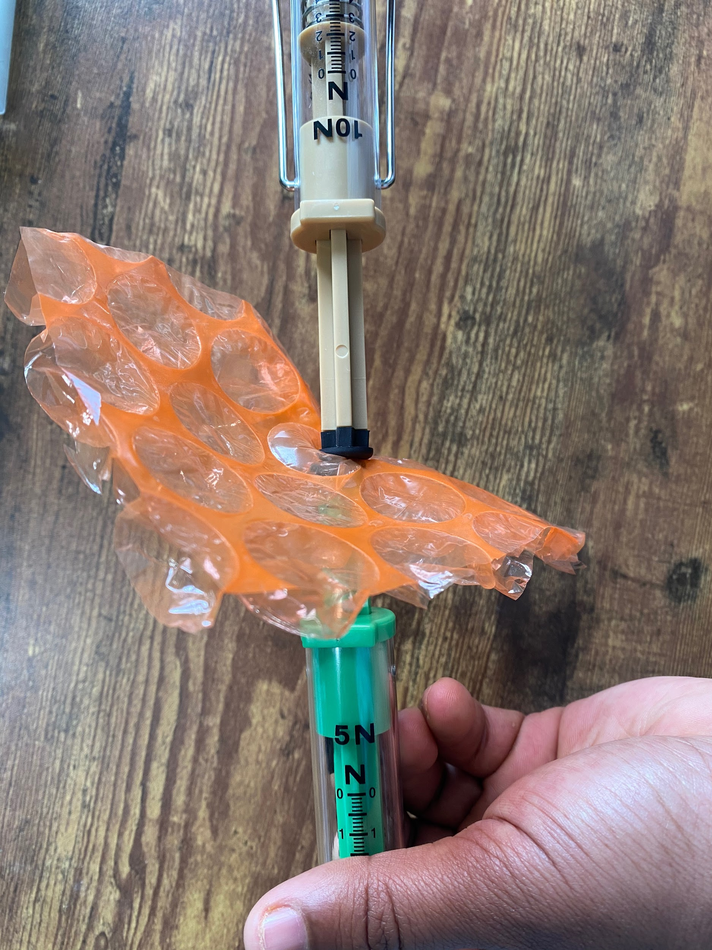
With a Small Group
Slide L
Are the contact forces the same on each object with a protective device in the middle?
Use two different spring scales to push in on each other. How do the readings compare?
Place a protective material between the two spring scales. How do the readings compare?
Swap scales with another group to get a different type of scale and try both of these again. Are the outcomes the same or different?
Notes:
Say, I think I have a way we can figure this out. Let’s see if we add a material in between two spring scales to see if the forces are reduced on one object or both objects equally.
Compare spring scales of different measurements. Project slide L. Pass out 1 5-n spring scale and 1 10-n spring scale to each group. Ask students to push the two scales together and observe the readings on each scale. Instruct students to select one protective material and place it in between the two scales. Students will use both scales to gently push in on the protective material and observe the reading on both scales. Have students swap out a scale and protective material with another group so that each group has 2 of the same spring scales and repeat the instructions.

Slide 13
Whole-Class Share
Slide M
What did you notice happening as you used different spring scales?
As you pushed in on each scale, what did you notice happening to the protective material?
What did you notice about the readings on each scale?
What felt different about pushing the scales with and without the protective material between them?
Notes:
Project slide M. Read the questions on the slide. Have students turn and talk about their ideas with a partner or their small group before sharing with the whole group.
Say, Interesting, the really protective materials seem to reduce the forces on both objects, regardless of the strength of those objects. It also seems that the really protective materials acted a little differently than the only slightly protective materials when we pushed on them. They may have moved easier or had different properties even though they are all solids. What is special about those force-reducing materials that you identified last class?
Ask students what they think is different about materials that reduce peak force more than other materials. Students should list things such as these:
They are squishier.
They seem to be lighter.
They can bend more.
Some students may want to look at the materials more closely. Explain to students that we can get a better idea of what might be happening by looking closer at the material properties. Tell students that we do have some microscopic images that might help us explain how the properties of the better protective materials differ from the properties of materials that did not reduce peak force as well.

Slide 14
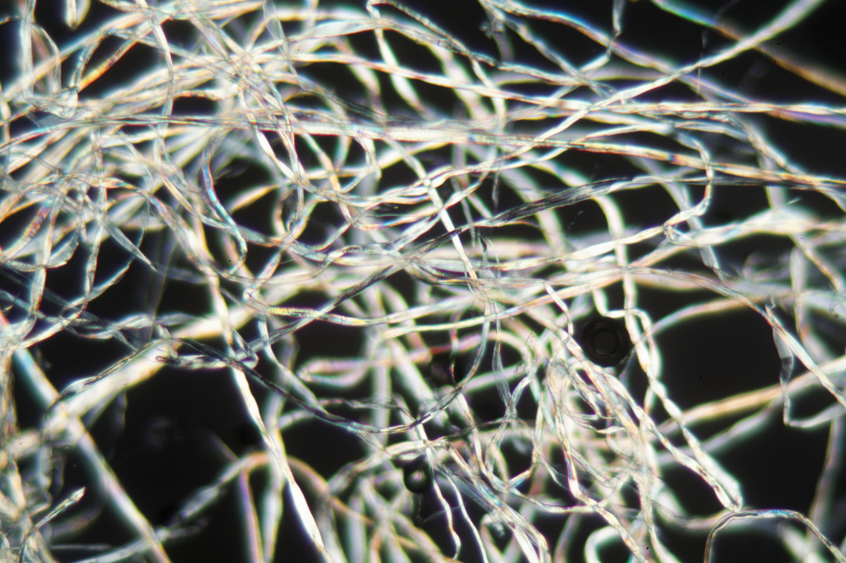


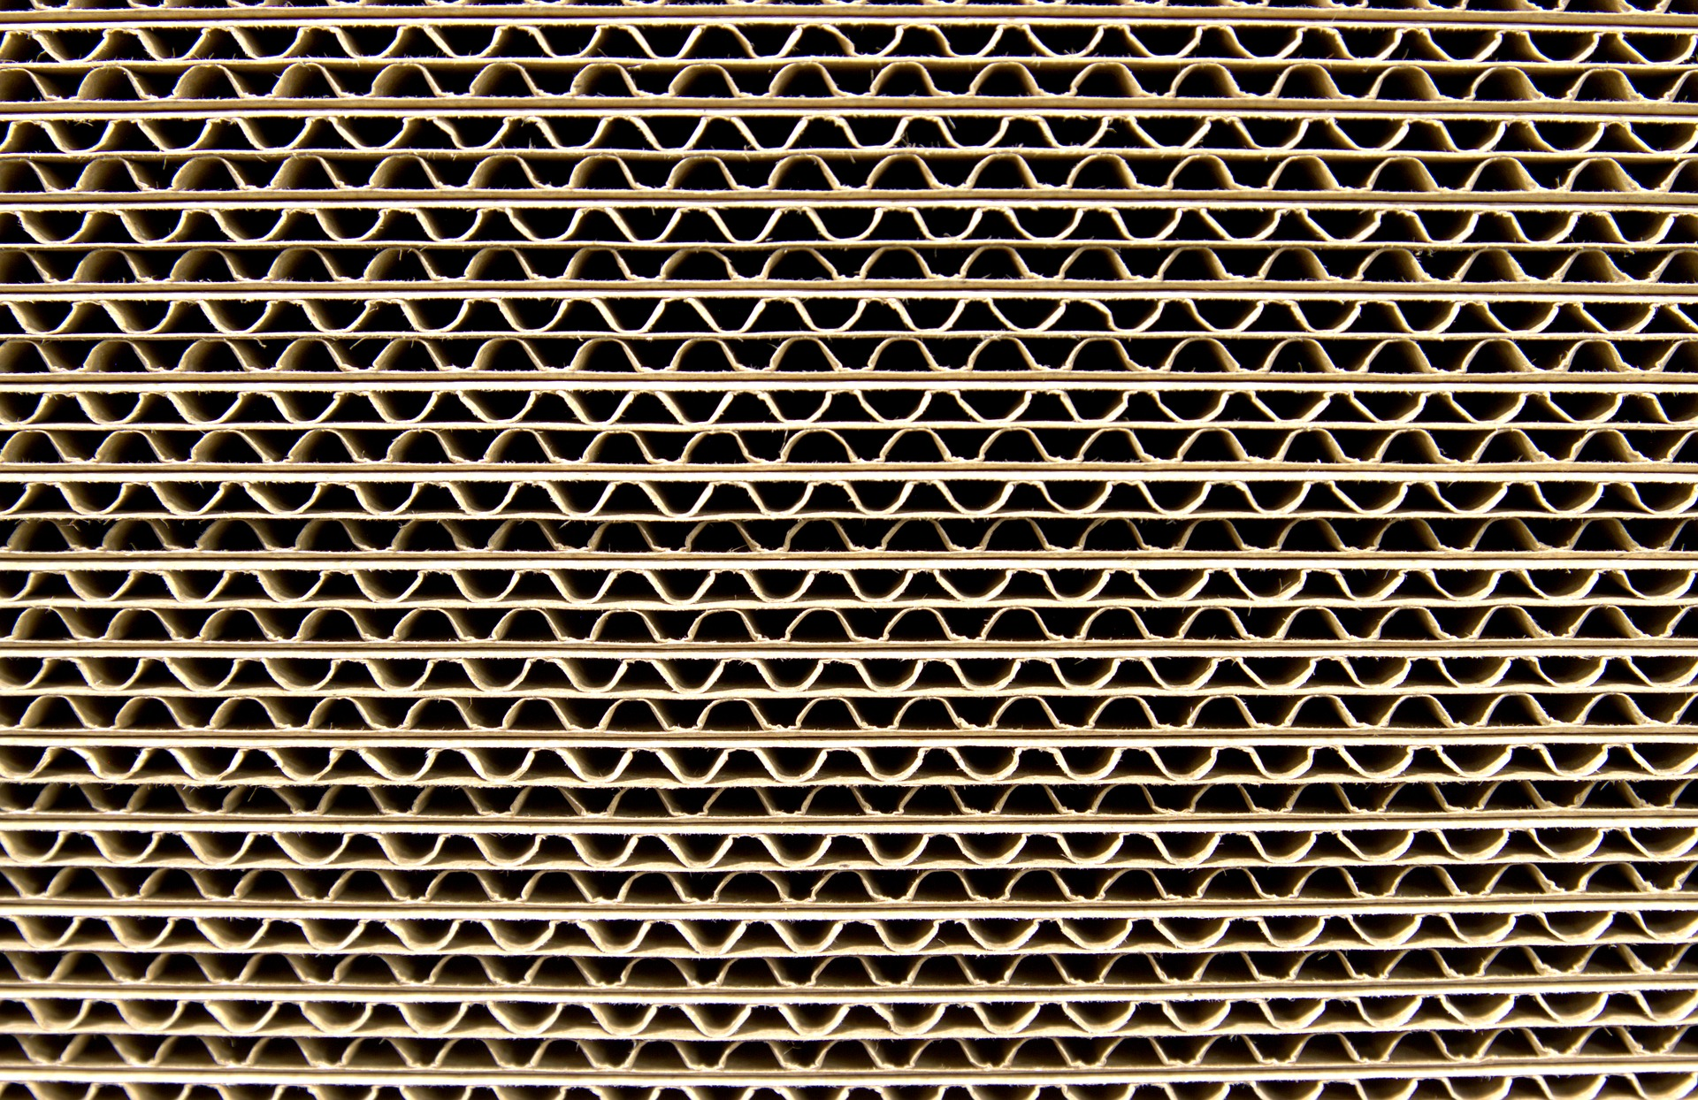
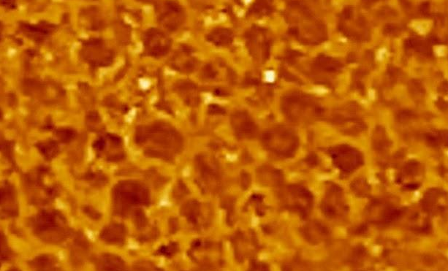
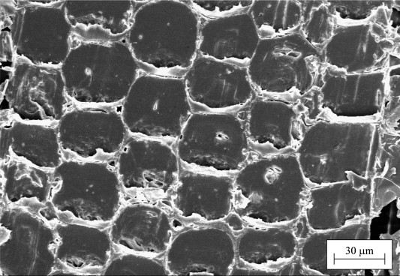
Material Structure
Slide N
Turn and Talk
cotton
metal
Here are zoomed-in images of some of the materials we tested. What do you notice about their structures?
Styrofoam
cardboard
foam
wood
Image credits: Cotton: weisschr; Wood: Reprinted from International Journal of Solids and Structures, 44, Silva, A. & Kiriakides, S., Compressive response and failure of balsa wood, 33, 2007, with permission from Elsevier. Rights reserved.
Notes:
Share perceived material property differences. Display slide N. Distribute Up Close Images to partner pairs. A color copy can also be found in the Student Procedures. Show students the different zoomed-in images of the various protective materials that we have tested and give time for students to look over the images on the handout. Have students turn and talk with a partner about what they see in common with the protective materials.

Slide 15

Comparing Ideas
Slide O
lL
Partner Share and Compare
Look back at your ideas you wrote in your notebooks about what specific features of the materials may be causing a reduction in peak forces.
Compare your ideas with a partner. You can use this time to revise or update your ideas if needed.
Be prepared to share your ideas with the whole class.
Notes:
Project slide O. Ask students to look back in their notebook to their responses about the specific features of materials that might be causing a reduction in peak forces. Have students share with a partner the specific features that they think contribute to the reduction of peak forces. They may revise any of their ideas at this time.
After students have had a chance to share with their partners, have students share with the whole class their ideas about perceived features. Students should identify these characteristics:
The materials can deform more than the materials that don’t reduce peak force as much.
The materials can change shape easily.
The materials seem to have space for air or air pockets.
Say, Interesting. It seems that we all think that the materials have air space or pockets in them and that may contribute to how they help reduce peak forces in a collision. One material we know that definitely has air pockets is bubble wrap. Let’s look at bubble wrap and cotton balls together and see what happens as we apply a force with our hands. Maybe if we use our finger sensory receptors that help us detect forces on our fingers, we can try to explain what the bubble wrap and cotton balls are doing as we apply a force.

Slide 16
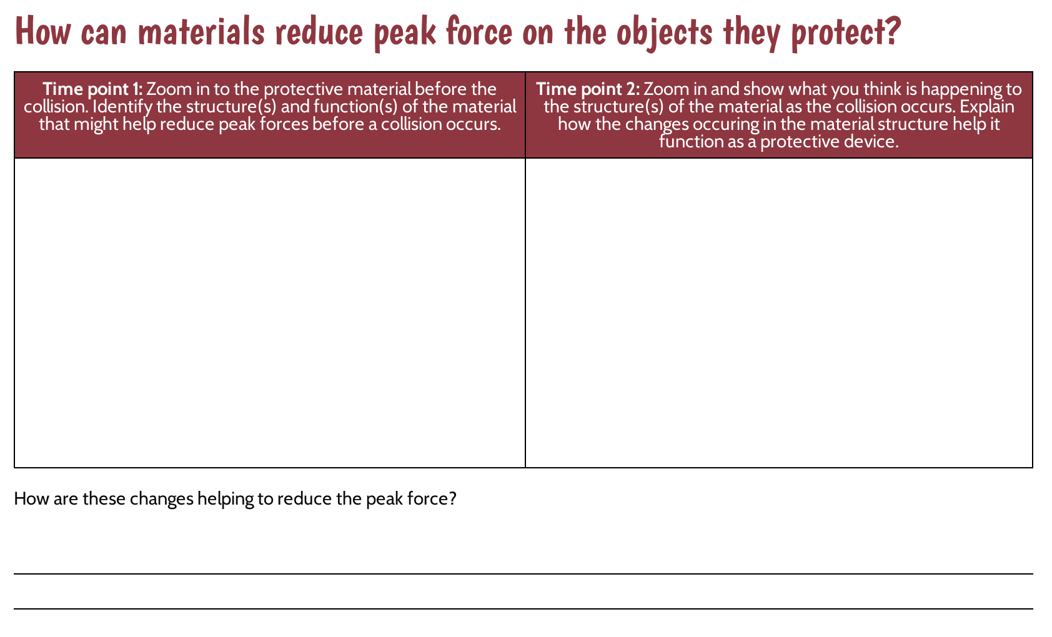
Constructing Explanations
Slide P
Use this handout to explain what happens to the protective material as a contact force is applied.
Notes:
Introduce handout. Display slide P. Distribute How can materials reduce peak force on the objects they protect?. Show students the two “Time point” boxes. Explain that the first box is for showing what the bubble wrap or cotton ball is like before a collision occurs. The second box is to identify the parts of the structure(s) they think are important and to show what happens to the structures of the bubble wrap or cotton balls as a contact force is applied. Ask students to use the second box to try to explain what the zoomed-in structures of the material are doing during a collision that helps to reduce the peak forces on the objects involved.
Distribute bubble wrap and cotton balls. Pass out a small piece of bubble wrap and a cotton ball to each student. Let students know that they will get only one small piece of bubble wrap, so they need to refrain from popping the bubble wrap until we are all done explaining how they think the material helps reduce peak force on the objects.
Allow students time to draft their ideas. With 2-3 minutes left in class, shift the focus to the last question. Have students try to explain the last question on the handout:
How are these changes helping to reduce the peak forces?
Collect How can materials reduce peak force on the objects they protect? at the end of class. Look for varying differences and explanations in the ways the protective material might be reducing peak forces. These varying ideas can be utilized to motivate student learning in Lessons 13-14. Ask students to throw away their bubble wrap as they leave class. Depending on the type of bubble wrap material, some types bubble wrap can also be recycled.

